Slide 1
Ch3-5 MultiTreading

Slide 2
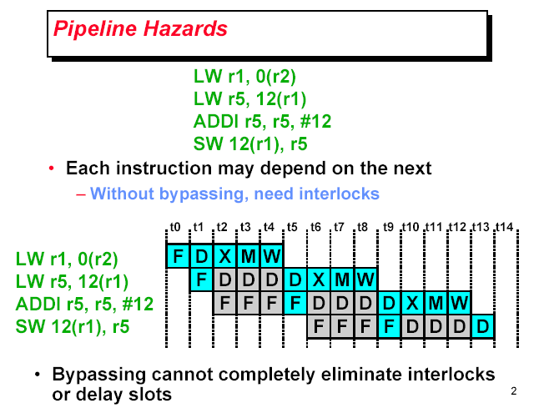

Slide 3
Multithreaded Software
Process
Each process has its unique address space
Can consist of several threads
Thread – each thread has its unique execution context:
Its own PC + registers + stack
All threads within a process share same address space
Private heap is optional
Multithreaded app’s: process broken into threads
Increase concurrency
Partial blocking
Centralized ( smaarter) resource management ( by process)

Slide 4
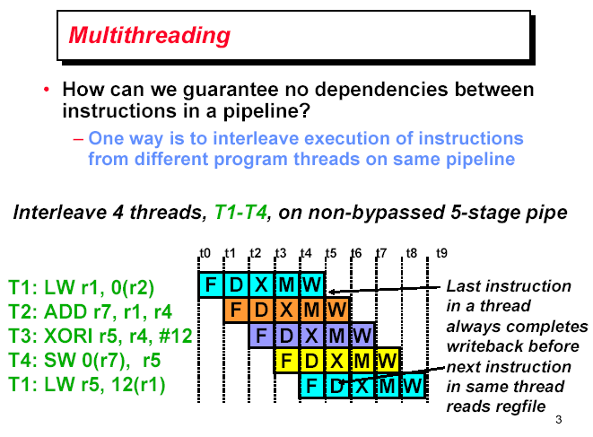

Slide 5
Multithreaded Architecture
Processor capable of executing multiple software threads
Can execute “simultaneously”
Thread can be HW switched without OS control
Shared resource
Sharing -> better resource utilization -> better throughtput
Can belong to the same process – but not have to !

Slide 6
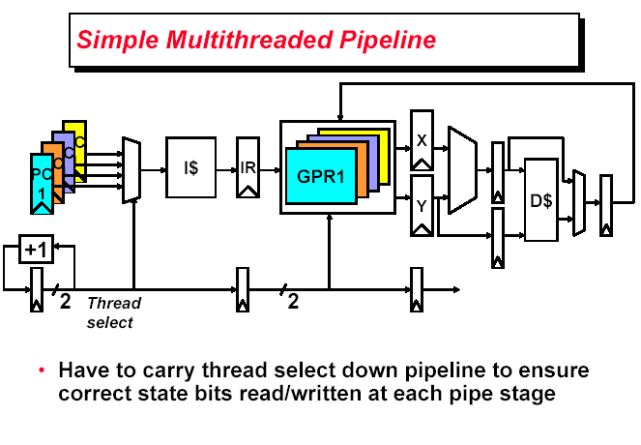

Slide 7
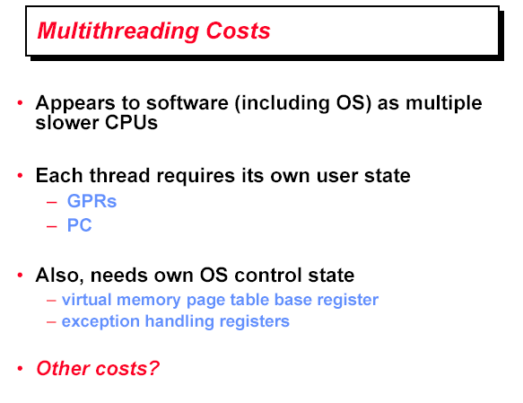

Slide 8
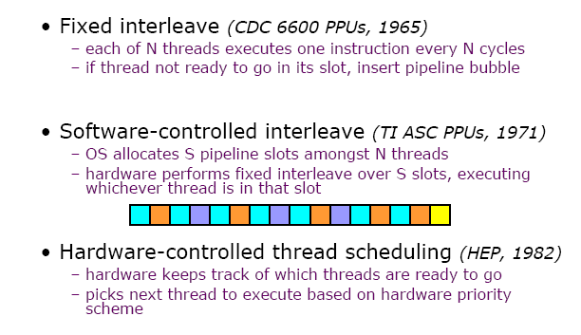
Thread scheduling policies

Slide 9
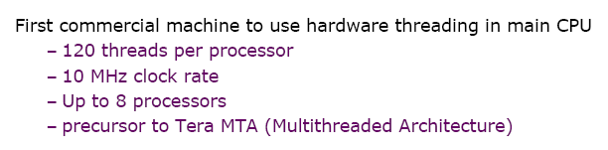
The Denelcor HEP was a uniform shared memory multiprocessor that used fine-grain multithreading to tolerate memory latency, synchronization latency, and even functional unit latency.

Slide 10
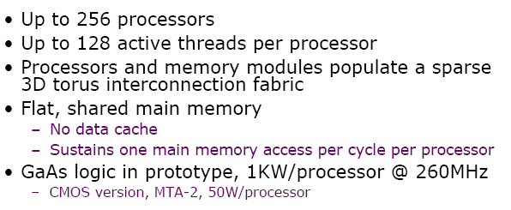
Notes:
The original Tera computer (also known as the MTA) Tera Computer Company turned out to be nearly un-manufacturable due to its aggressive packaging and circuit technology.
The Cray MTA-2 is a Shared-Memory MIMD computer marketed by Cray Inc.
The MTA-2 was not a commercial success but pioneered several techniques.
Hardware-based multithreading.
Automatic parallelization.
Low-overhead thread synchronization.

Slide 11


Slide 12


Slide 13
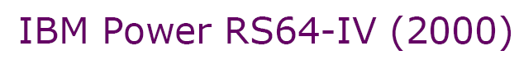

Slide 14
Multithreading design choices

Slide 15
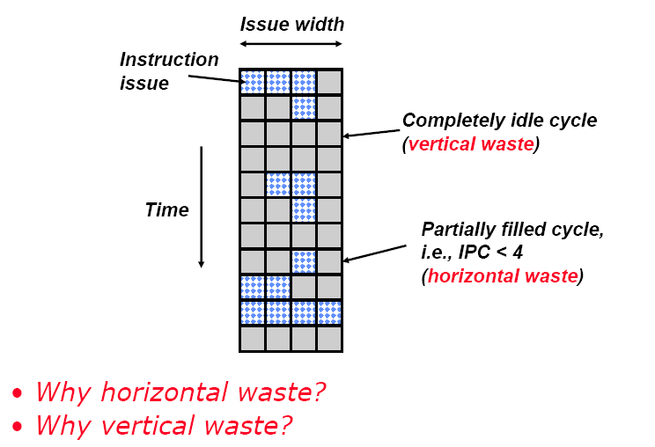
Cache misses

Slide 18


Slide 19

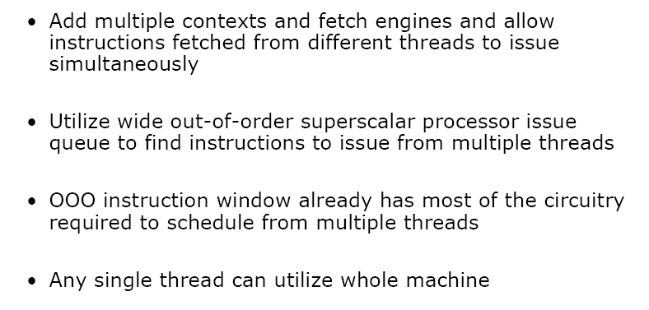

Slide 20


Slide 22
Design Challenges in SMT
Trade-off between fine-grained implementation performance and single-thread performance.
preferred thread : might sacrifices throughput
Less likely to have a mix of instructions from several threads.
Maximize single-thread performance, should fetch as far ahead as possible, and have the fetch unit free when a branch is mispredicted or miss occur in prefetch buffer.

Slide 23
Design Challenges in SMT
A larger register file to hold multiple context
Not affecting the clock cycle, such as in instruction issue, in instruction completion.
Ensuring that Cache and TLB conflicts do not cause performance degradation.

Slide 24
Power 5 with SMT support vs Power 4
Increasing the associativity of L1 icache and iTLB
Adding per-thread load and store queues
Increasing the size of L2 and L3
Adding separate instruction prefetch and buffering
Increasing virtual registers from 152 to 240
Increasing size of several issue queues

Slide 25
Pentium-4 Hyperthreading

Slide 26
HT Technology Architecture
Front End
Execution trace cache
Microcode store ROM (MSROM)
Instruction translation look-aside buffer (ITLB) and branch prediction
IA-32 instruction decode
Micro-op queue
System Bus
Bus unit
3rd level cache
Optional server product
2nd level cache
1st level cache
4 way
Fetch/
Decode
Trace Cache
MS ROM
OOO
Execution
Retirement
BTBs/
Branch Prediction

Slide 27
Front End
Responsible for delivering instruction to the later pipe stages
Trace cache hit
When the requested instruction trace is present in trace cache
Trace cache miss
Requested instruction is brought in the trace cache from L2 cache

Slide 28
Trace Cache (TC) Hit Front End
IP
IP
Micro-Op Queue
Trace Cache
Two sets of instruction pointers
Two logical processors arbitrates access to TC every clock cycle
If one logical processor stalled, then other logical processor can use the full bandwidth of TC
Notes:
An usual scenario is: there is a TC hit, the instruction will be just taken from TC and will be delivered to micro-op queue.
Most instructions in the program are fetched and executed from TC. Two sets of instruction pointers track the progress of two s/w threads (on 2 logical processors). Two logical processors arbitrates access to TC every clock cycle. If both processors want access to TC, then one of them is granted access first and access to other is given in alternating clock cycle. If one of the logical processors is stalled or is waiting on some event, then other logical processor can use the full band-width of trace cache I.e. every clock cycle. (Full bandwidth 1 micro-op/clock)

Slide 29
Trace Cache Miss Front End
L2 Access
Buffer
Decode
Queue
ITLB
Decode
L2 Access
(ping-pong)
(ping-pong)
(ping-pong)
Micro-op Queue
Trace Cache Fill
Notes:
(This slide describes how TC misses are handled.) Its important to go over this, since in the next foils, we will see the details the implementation of all these resources from HT Technology view-point.
When there is a TC miss, machine fetches and decodes instruction from integrated L2 cache and the decoded micro-op is then placed into Trace cache. ITLB receives request from TC to deliver new instruction and then it translates the next IP address to physical address. When a request is send to L2 cache, instruction bytes are returned. These bytes are placed in streaming buffers, which hold the bytes until they are decoded.

Slide 30
HT Technology Architecture
Back End
Allocator
Register rename
Instruction scheduling
Execution units
Retirement
System Bus
Bus unit
3rd level cache
Optional server product
2nd level cache
1st level cache
4 way
Fetch/
Decode
Trace Cache
MS ROM
OOO
Execution
Retirement
BTBs/
Branch Prediction
Notes:
It consists of allocator and register rename, Instruction Scheduling, execution units and retirement unit. As we know that micro-op queue is partitioned and contains micro-ops from both logical processors, allocator alternates every clock cycle, selecting the micro-ops. We will see the details of each of these logic units in next foils.
If there are micro-ops from both logical processors in micro-op queue, allocator will alternate selecting micro-ops every clock cycle.

Slide 31
Detailed Pipeline
Micro-op Queue
Sched.
Register Read
Register
Rename
Queue
Allocate
Execute
Retire
Register Write
L1 D Cache
Notes:
This part of machine re-orders instructions and executes them.

Slide 32
Allocator Back End
Allocates many of the key machine buffers including
126 re-order buffer entries
128 integer and floating point physical registers
48 load 24 store buffers
When HT Technology is enabled, each logical processor can use maximum of 63 re-order buffer entries, 24 load buffers and 12 store buffers
Notes:
Allocator takes the decoded micro-ops from micro-op queue and allocates many of the key machine buffers including 126 Re-order buffers entries
128 integer and floating point reg. And 48 store and 24 load buffers. And when HT Technology is enabled, some of these resources are split. For example, each logical processor can use maximum 63 re-order buffer entries, 24 load buffers and 12 store buffers.

Slide 33
Register Rename Back End
There are two Register Alias Tables (RAT) for each processor
Rename done in parallel with allocator logic
Once done, micro-ops are placed into two sets of queues: MIAQ(memory instruction address queue) and GIAQ(general instruction address queue)
Queues are partitioned such that micro-ops from each logical processor can use at most half the entries
Notes:
Register Rename, renames the architectural IA-32 registers onto machines physical registers. This allows the 8 general purpose registers to be dynamically expanded to use the available 128 physical registers.
As we have seen in the beginning, each logical processor has its own architecture state, so there are two Register Alias Table for each processors. It keeps track of the latest version of each architectural registers to tell the next instruction where to get its operands from.
This works in parallel to the allocation logic, so rename logic works on same micro-op to which allocator is assigning resource.
Once, allocation and rename process is completed, micro-ops are placed in two sets of queues: one for memory operations and the other of all other operations. These queues are also partitioned, so each logical processor can use at the most half entries.

Slide 34
Instruction Scheduling Back End
Five schedulers are used to schedule different types of micro-ops
Both MIAQ and GIAQ send micro-op to five schedulers as fast as they can
Each scheduler has its own scheduler queue
Micro-ops are simply evaluated based on dependent inputs and availability of execution resources
To avoid deadlock, there is a limit on number of active entries that a logical processor can have in scheduler’s queue
Notes:
5 schedulers are used to schedule different types of micro-ops for various execution units. Collectively all these schedulers can dispatch up to 6 micro-ops per clock cycle. Each of the schedulers has its own queue with 8-12 entries and schedulers determine when micro-ops are ready to execute based on readiness of their dependent input registers and availability of execution unit resources. No priority is given to any one logical processor.
MIAQ and GIAQ send micro-ops to 5 schedulers as fast as they can and micro-ops for 2 logical processors are alternated every other clock cycle.
To avoid deadlock and ensure fairness , there is a limit on number of active entries that a logical processor can have in each scheduler’s queue. This limit depends on size of scheduler’s queue.

Slide 35
Execution units Back End
After execution, micro-ops are placed in re-order buffer. It decouples execution stage from retirement stage
Re-order buffer (ROB) is partitioned such that each logical processor can use half entries
Intel and the Intel logo are trademarks or registered trademarks of Intel Corporation or its subsidiaries in the United States or other countries
Notes:
Execution units: since source and destination registers were renamed earlier to physical registers (done in register rename) in shared physical register pool, micro-ops access physical register file to get there destination, and they write the result back to physical register file. The forwarding logic forwards results to other executing micro-ops by comparing physical register numbers without understanding of logical processors.

Slide 36
Retirement Back End
Tracks when micro-ops from two logical processors are ready to be retired, then retires the micro-ops by alternating between two logical processors

Slide 37
HT Technology Architecture
Memory Subsystem
DTLB
L1 data cache
L2 unified cache
L3 unified cache
System Bus
Bus unit
3rd level cache
Optional server product
2nd level cache
1st level cache
4 way
Fetch/
Decode
Trace Cache
MS ROM
OOO
Execution
Retirement
BTBs/
Branch Prediction
Notes:
Memory sub-system includes DTLB, low latency L1 data cache, L2 unified cache and L3 unified cache. The scheduler sends data load/store without regard to which logical processor sends it and memory sub-system handle them as they come.
The Scheduler sends load or store micro-ops without regard to logical processors and memory subsystem handles them as they come.

Slide 38
DTLB Memory Subsystem
Tagged resource
Each entry in dual translation lookaside buffer (DTLB) includes a logical processor ID tag
Each processor has reservation register to ensure fairness and forward progress in processing DTLB misses
Notes:
DTLB translates the virtual address to physical address. It has 64 fully associative entries , each entry can map 4K or 4MB page. And although this is a shared structure, it includes a logical processor tag. Each logical processor has a reservation register to ensure fairness and forward progress in processing DTLB misses.
L1 data cache is 4-way set associative with 64 byte lines. It is a write-through cache, I.e. writes are always copied to L2 cache.
L2 and L3 caches are 8-way set associative with 128-byte lines. Because two logical processors can share data in cache, there is a possibility for cache conflicts which can lower the performance. But there is also possibility of sharing the data in the cache. E.g. one of the logical processors may prefetch instruction or data required by the other into the cache. This is common in server application code.

Slide 39
Memory Subsystem L1 Data Cache, L2 Cache, L3 Cache
Both logical processors can share all entries in all three levels of cache

Slide 40
Bus
Logical processors are treated on first-come first-serve basis. Priority is not given to any logical processor
Distinction between requests from two logical processors are maintained
Requests to APIC and interrupt delivery resources are unique and separate per logical processor
Notes:
Memory requests that are not satisfied by cache hierarchy are serviced by bus logic. From service perspective, requests from logical processors are treated on first come first served basis, with queues and buffering space appears shared to both logical processors. In the bus queue, the distinction between two logical processors is reliably maintained. Since two logical processors have different APIC, requests to APIC and interrupt delivery resources are treated uniquely and separate per logical processor.

Slide 42


Slide 43
Sun T1 Multiprocessor
Focus on Thread Level Parallelism
Commercial application oriented
Small single-issue core employ multithreading
Multi core on chip

Slide 44
Single Thread Design
L2 cache is getting larger with less performance contribution
Power efficiency decrease
Hot-spot
Lower processor
utilization

Slide 45
Single Thread design multiple issue

Slide 46
Hardware Multi Threading

Slide 47
Chip MultiThreading

Slide 48
Why CMT works ?

Slide 49
T1 Architecture
8 core/chip
4 Treads/core
1 FPU shared for 8 cores
Core connected via crossbar switch(134.4GB/s)
High-bandwidth, 12-way associative 3MB L2 cache
4 DDR2 channels (23GB/s)
Power < 80W
`300M transistors
378 mm² die
1 core

Slide 50
Chip Layout
L1 cache: 16KB Icache, 32B line; Dcache, 8KB, 16B line; 4-way set associative, 64B block, L1 miss penalty=23 cycles,
L2 cache: 4 banks, each 750KB, 64B block, L2 miss penalty = 110 cycles
L1 cache coherence is enforced by directory associate with each L2 cache block
Memory controller on chip to decrease miss penalty

Slide 51
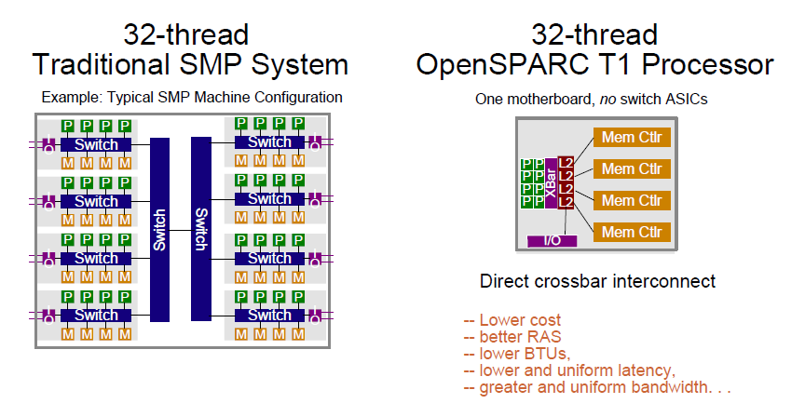
Compare with SMP
BTU: british theraml Unit

Slide 52
Core structure
4 threads /core
Single issue
6 stage pipeline
Unique resources/thread
Registers
Portions of I-fetch datapath
Store and Miss buffers
Resource shared by 4 threads
Caches, TLBs, Exe Units
Pipeline registers and Data path
Core area = 11mm² in 90nm
MT adds ~20% area to core

Slide 53
T1 processor core pipeline

Slide 54
Thread Selection Policy
Switch among available ( ready to run) threads every cycle
Priority given to least-recently-executed thread
Thread becomes not-ready-to-run due to:
Long latency operations like load, branch, mul, or div ( load, branch incur 1 3-cycle delay )
Pipeline stall when cache miss, trap, or structure hazard

Slide 55
Instruction Fetch/Switch/Decode Unit ( IFU)
I-cache
16KB data, 4ways, 32B line
Single-ported Instrctuion Tag
Dual-ported(1R/1W) Valid-bit array
Invalidate operations access Vilid-bit array, not instruction Tags
Pseudo-random replacement
Fully associative Instruction TLB
64 entries, Page sizes: 8K, 64K, 4M, 256M
Multiple hits in TLB prevented by doing auto-demap on fill
2 instructions fetched each cycle

Slide 56
Windowed Int Register file
5KB 3R/2W/1T structure
>640 64b regs
Only the 32 registers from current window is visible to thread
8 global + 24 window register
Window changing in background under thread switch
Single cycle R/W accwss

Slide 57
Execution Units
Single ALU and shifter. ALU reused for branch address and virtual address calculation.
Integer Multiplier
5 clock latency, throughput of ½ per cycle
Contrains accumulate function for Mod Arithmetic
1 integer mul allowed outstanding per core
Multipiier shared between Core Pipe and Modular Arithmetic unit on a round robinn basis
Simple divider, with one divide outstanding per core
Thread issuing a MUL/DIV will rollback and switch out if mul/div units is occcupied.

Slide 58
Load Store Unit (LSU)
D-Cache complex
8KB data, 4 ways, 16B line
Single ported Data Tag
Dual ported(1R/1W) Valid bit array
Pseudo-random replacement
Load are allocating, stores are non allocating
8 entry store buffer per thread, unified into single 32 entry array, with RAW bypassing

Slide 59
LSU(continued)
Crossbar interface
LSU priorities requests to the crossbar for FPops, streaming ops, I and D misses, stores and interrupts.
Request priority
Imiss>ldmiss>stores, {fpu, strm, interrupt}
Packed assembly for pcx.
Handles return from crossbar and miantains order for cache updates and invalidtes.

Slide 60
Other Functions
Support for up to 64 pending interrupts per thread
Support for 6 trap levels. Traps cause pipeline flush.
Floating Point
The thread switch out when detecting ans FPop
Fpop is further decoded and FRF is read
FPop with operands are packetized and shipped over the crossbar to the FPU
FPU returned the result via crossbar
Write back to FRF and thread restart

Slide 61
Cross Bar
Each requestor queues up to 2 packets per destination
3 stage pipeline: request, arbitrate and transmit
Oldest requestor first
Core to cache bus;
Address+double word store
Cache to core bus
16B line 32B Icache line fill delivered in 2 back to back clock cycles

Slide 62
L2 Cache
3MB, 4-way banked, 12-way associative, writeback
64B line size, 64B interleaved between banks
Latency: 8 clocks for load, 9 clocks for I-miss, critical chunk first
16 outstanding misses per bank → 64 total
Coherence maintained by shadowing L1 tags in an L2 directory structure
L2 is global visibility. DMA from IO is serialised write traffic from cores in L2
L2 has a 8-stage pipeline ( C1-C8)

Slide 63
L2 Cache --Directory
Directory shadows L1 tags
2048 entries, half-half for Icache and Dcache
L1 set index and L2 bank interleaving is such that ¼ of L1 entries come from each L2 bank
On and L1 miss, the L1 replacement way and set index identify the physical location of tag
On a store, write invalidate will be done
Invalidate operation are pointer to the physical location of L1. ( no tag lookup in L1)
An acknowledgement packet is sent to the request CPU, an invalidation packet sent to all other core

Slide 64
L2 Cache Single Bank
Arbiter ( instruction from CCX, DMA instruction, stall signals from pipeline, instruction from FB and MB )
L2 tag
L2 VUAD array –Valid, Used, Allocated( set when a line is picked for replacement) Dirty
L2 data
Input Queue ( 16 entry FIFO ) – packets arriving on the PCX
Output Queue ( 16 entry FIFO ) – operations waiting for access to CPX(cache-to-processor interface)
Snoop input Queue ( 2-entry FIFO)
Miss buffer (MB) (L2 misses, same line address with previous miss or write-back buffer, atomics and partial stores etc)
Fill buffre ( temp store data from DRAM )
Write-back buffer
Remote DMA write buffer ( 4 entry ) for DMA write
L2 cache directory –coherency management and maintain inclusive property

Slide 65
Coherence/consistency
Load update directory & fill the L1 on return
Stores are non-allocating in L1
TSO, PSO, RMO ( one TSO store outstanding to L2 per thread)
Check directory and determine L1 hit
Directory send store ack/inv to core
Store update happens to Dcache on store ack
Crossbar orders responses across cache banks
3 atomic instructions are processed by L2 cache
LDSTUB, SWAP, Compare and swap(CAS)
Two passes downto cache pipeline

Slide 66
On chip Mem controller
4 independent DDRII DRAM channels
Upto 128GB memory size
25GB/s peak bandwidth
Schedules across 8 rds + 8 writes
128+16b interface, chipkill support, correction, byte error detection
Designed to work from 125-200Mhz

Slide 67
T1 Performance
Thank you.

Slide 68
Conclusion
Sun T1 provides much better performance in terms of performance/watt, especially for TPC-C-like and SPECJBB05 benchmark.
TLP approach is much more power efficient than an ILP-intensive approach for multithreaded applications.
CMT may provide a way to increase performance in a power efficient fashion.

